Slide 1
Montreal Cognitive Assessment
Validation Study for Mild Cognitive Impairment and Alzheimer Disease
Notes:
So im gonna talk about the paper called Montreal Cognitive Assessment, which is a validation study for mild cognitive impairment and alzheimer disease.

Slide 2
Abstract
Screening tests for Mild Cognitive Impairment and Alzheimer disease
Proposed as a cognitive screening test: The Montreal Cognitive Assessment (MoCA)
Already in-use test: Mini-Mental State Examination (MMSE)
Compare the results of the two tests
Conclude by claiming that the MoCA test is a better tool for the intended use than MMSE
Notes:
The paper aims to validate a recently proposed cognitive screening test,the Montreal Cognitive Assessment (MoCA) as a screening test for Mild Cognitive Impairment and ALzheimer disease. This is done through an analysis of diagnostic accuracy.
The paper uses a number of quantitative tests to compare the results of the most common use test (the Mini-Mental State Examination) and the new MoCA test.
Based on these tests the paper conclude by claiming that the new MoCA test is a better cognitive tool than the Mini-Mental state Examination for the screening and monitoring of Mild Cognitive Impariment and Alzheimers disease.

Slide 3
The tests
Score 0-30 points (higher scores indicates better cognitive performance)
The Montreal Cognitive Assessment (MoCA)
Executive functions
Visuospatial abilities
Short-term memory
Language
Attention, concentration and working memory
Temporal and spatial orientation
Notes:
Both tests are on paper tests where the test subject are given a score between 0 and 30 where a high score means a better cognitive performance.
In the paper its claimed that the MMSE is a is a widely recognized and used screening tool, so its not actually described in the paper. —> but is a set of 11 questions that doctors and other healthcare professionals commonly use to check for cognitive impairment
The new screening tool (MoCA) is based on 6 cognitive domains:
Executive functions
Visuospatial abilities
Short-term memory
Language
Attention, concentration and working memory
Temporal and spatial orientation
Visuospatial ability refers to a person's capacity to identify visual and spatial relationships among objects
Where the results of the six domains should form an overall score which gives us a result of the test-takers cognitive performance which again can be used to diagnose the test-takers within cognitive impairments.

Slide 4
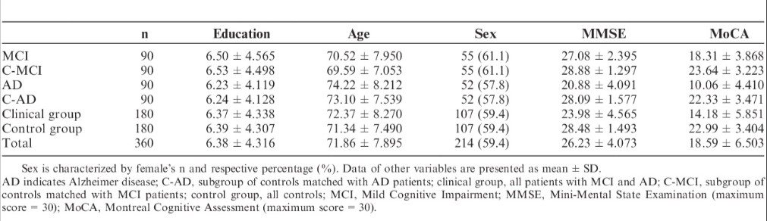
Participants
Participants
Total sample consist of 360 participants
Distributed between three subgroups:
Mild Cognitive Impairment (90)
Alzheimer disease (90)
Control group (180)
Control group where matched with the patients sex, age and education level.
Notes:
The participants is a sample of totally 360 people distributed between three subgroups: 90 people with mild cognitive impairment, 90 people with alzheimer's disease and 180 people (90 for each of the previous two groups) in the control group.
The patients were recruited from the dementia Clinic of Coimbra University Hospital and control groups from a MoCA normative study for of the intended populasjon.
The control group where matched with the patients sex, age and education level.

Slide 5
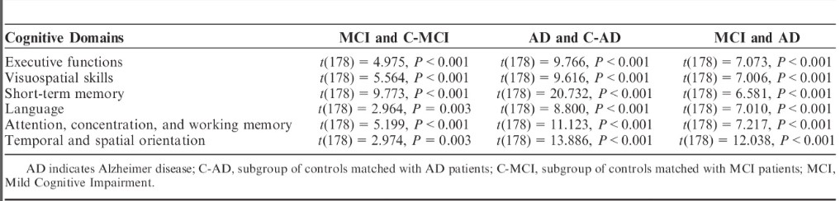
Statistical Analysis
Notes:
The study used a t-test and looked at the p-value to look at the group differences, as seen in this figure. Where MCI indicates Mild Cognitive Impairment, C-MCI indicates control group for the group. AD means Alzheimer's disease and C-AD the control group. They have divided the evidences into the six cognitive domains within the MoCA test.

Slide 6
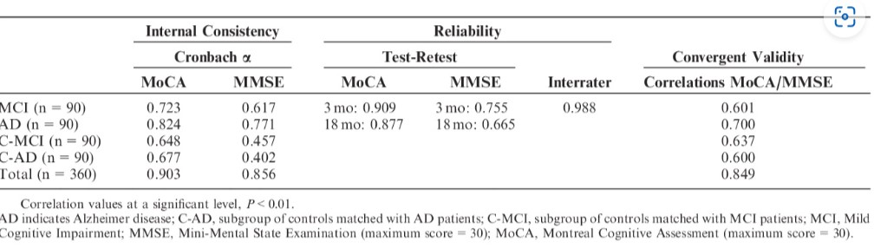
Statistical Analysis
Notes:
the first one here showing internal consistency by cronbach alpha, within Mild cognitive Impairment, Alzheimer's Disease, the control groups and the whole study group.
To assess test-retest reliability, intraclass correlation between scores at baseline and at follow-up after 3 and 18 months for the control patients were calculated, Which is what the second columns shows.
The third shows correlation between the scores of the two tests.

Slide 7
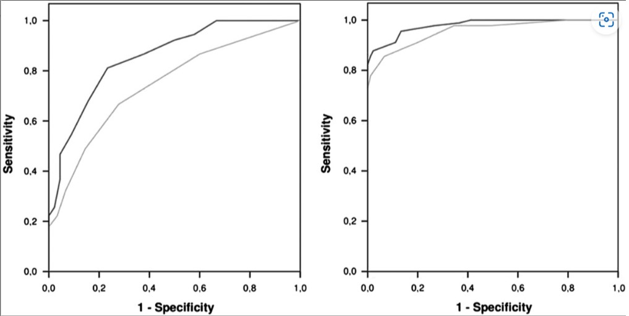
Statistical Analysis
Notes:
For diagnostic accuracy of the MoCA and the MMSE the study used a curve analysis where the areas under the curve can vary between 0.and 1, with a larger area under the curve indicating better diagnostic accuracy.
Where the MoCA is the dark grey line and MMSE is the light gray line. Where the left box is detecting Mild Cognitive Impairment and the right is detecting Alzheimer's Disease.

Slide 8
Validity evidences
Evidance based on response processes
Evidance based on internal structure
Notes:
They use evidence based on response processes, since they use quantitative methods by comparing test scores from the MoCA and MMSE tests, which is collected from a study sample carefully selected to test what's intended.
The study also use evidence based on internal structure which is when the relationships among test items and tests components conform to the construct on which the proposed test score interpretations are based. This is used since the study looks at the relationship between the test elements by looking at both the different subgroups relationship to each other but also the Mild Cognitive Impairment and the alzheimer disease group first once during the test, then again 3 months later and once more 18 months later.

Slide 9
Results and validity of the test score interpretation
More pronounced difference between groups with MoCA.
Statistically significant differences
Curve analysis
Notes:
The analysis of group differences indicates that both instruments are able to distinguish between the clinical group and the control groups. However, the differences between the groups were much more pronounced when the MoCA was used, in comparison with the MMSE.
Also the results showed statistically significant differences for all cognitive domains of the MoCA and in all group comparisons, which proves a higher capacity of the MoCA to differ between normal aging and aging with cognitive decline, as well as between Mild Cognitive Impairment and alzheimer's disease.
The curve analysis shows that the MoCA is better suited to correctly diagnose patients than the MMSE.
All together i would say that the conclusion and validity evidence of this paper is based on actual findings based on a number of different quantitative tests. They do not find evidence based on consequences of testing, but through response processes and internal structure. I would say the results are well validated and is legitimate results.
NOT CONTENT (litteratur review), consequence of testing or relations to other variables.

